Slide 1
COMP 110/L Lecture 11 Maryam Jalali
Some slides adapted from Dr. Kyle Dewey

Slide 2
Outline
@Test vs. assertEquals
Boolean operations
&&
||
•!
Complex if conditions

Slide 3
@Test vs.
assertEquals

Slide 4
@Test vs.
assertEquals
@Test defines a test
assertEquals checks a condition
Can have a @Test containing no assertEquals
Test always passes
Can have multiple assertEquals per @Test
Test passes if all assertEquals are ok
Notes:
-Generally we want to define one assertEquals per @Test, but sometimes this is inconvenient

Slide 5
Example: MultiAssert.java MultiAssertTest.java

Slide 6
Boolean Operations

Slide 7
Boolean Operations
You’re already familiar with operations returning boolean

Slide 8
Boolean Operations
You’re already familiar with operations returning boolean
3 < 6

Slide 9
Boolean Operations
You’re already familiar with operations returning boolean
3 < 6
2 == 7

Slide 10
Boolean Operations You’re already familiar with operations returning boolean 3 < 6
2 | == | 7
8 | >= | 8

Slide 11
Bigger Expressions
Can chain boolean expressions with AND (&&).
Semantics: only true if both sides are true.

Slide 12
Bigger Expressions
Can chain boolean expressions with AND (&&).
Semantics: only true if both sides are true.
3 > 1 && 1 < 5

Slide 13
Bigger Expressions
Can chain boolean expressions with AND (&&).
Semantics: only true if both sides are true.
3 > 1 && 1 < 5
true

Slide 14
Bigger Expressions
Can chain boolean expressions with AND (&&).
Semantics: only true if both sides are true.
3 > 1 && 1 < 5
true
1 > 3 && 1 < 5

Slide 15
Bigger Expressions
Can chain boolean expressions with AND (&&).
Semantics: only true if both sides are true.
3 > 1 && 1 < 5
true
1 > 3 && 1 < 5
false

Slide 16
Bigger Expressions
Can chain boolean expressions with AND (&&).
Semantics: only true if both sides are true.
3 > 1 && 1 < 5
true
1 > 3 && 1 < 5
false
3 > 1 && 5 < 1

Slide 17
Bigger Expressions
Can chain boolean expressions with AND (&&).
Semantics: only true if both sides are true.
3 > 1 && 1 < 5
true
1 > 3 && 1 < 5
false
3 > 1 && 5 < 1
false

Slide 18
Truth Table
Truth tables show the result of combining any two boolean expressions using the AND operator and the OR operator (or the NOT operator).
You should memorize/learn these values.
condition 1 (e.g., X) | condition 2 (e.g., Y) | X AND Y ( X && Y )
false | false | false
false | true | false
true | false | false
true | true | true

Slide 19
Example:
And.java

Slide 20
Boolean Or
boolean expressions can also be combined with OR (||) Semantics: true if either side is true.

Slide 21
Boolean Or
boolean expressions can also be combined with OR (||) Semantics: true if either side is true.
3 > 1 || 5 < 1

Slide 22
Boolean Or
boolean expressions can also be combined with OR (||) Semantics: true if either side is true.
3 > 1 || 5 < 1
true

Slide 23
Boolean Or
boolean expressions can also be combined with OR (||) Semantics: true if either side is true.
3 > 1 || 5 < 1
true
2 < 1 || 8 < 9

Slide 24
Boolean Or
boolean expressions can also be combined with OR (||) Semantics: true if either side is true.
3 > 1 || 5 < 1
true
2 < 1 || 8 < 9
true

Slide 25
Boolean Or
boolean expressions can also be combined with OR (||) Semantics: true if either side is true.
3 > 1 || 5 < 1
true
2 < 1 || 8 < 9
true
2 < 1 || 9 < 8

Slide 26
Boolean Or
boolean expressions can also be combined with OR (||) Semantics: true if either side is true.
3 > 1 || 5 < 1
true
2 < 1 || 8 < 9
true
2 < 1 || 9 < 8
false

Slide 27
Truth Table
Truth tables show the result of combining any two boolean expressions using the AND operator and the OR operator (or the NOT operator).
You should memorize/learn these values.
condition 1 (e.g., X) | condition 2 (e.g., Y) | X OR Y ( X || Y )
false | false | false
false | true | true
true | false | true
true | true | true

Slide 28
Example:
Or.java

Slide 29
Boolean Not
Can negate a boolean expression with not (!).
Semantics: !true == false and !false == true.

Slide 30
Boolean Not
Can negate a boolean expression with not (!).
Semantics: !true == false and !false == true.
!(1 < 2)

Slide 31
Boolean Not
Can negate a boolean expression with not (!).
Semantics: !true == false and !false == true.
!(1 < 2)
false

Slide 32
Boolean Not
Can negate a boolean expression with not (!).
Semantics: !true == false and !false == true.
!(1 < 2)
false
!(1 > 7)

Slide 33
Boolean Not
Can negate a boolean expression with not (!).
Semantics: !true == false and !false == true.
!(1 < 2)
false
!(1 > 7)
true

Slide 34
Boolean Not
Can negate a boolean expression with not (!).
Semantics: !true == false and !false == true.
!(1 < 2)
false
!(1 > 7)
true
!(1 < 2 && 1 > 3)

Slide 35
Boolean Not
Can negate a boolean expression with not (!).
Semantics: !true == false and !false == true.
!(1 < 2)
false
!(1 > 7)
true
!(1 < 2 && 1 > 3)
true

Slide 36
Truth Table
Truth tables show the result of combining any two boolean expressions using the AND operator and the OR operator (or the NOT operator).
You should memorize/learn these values.
condition 1 (e.g., X) | NOT X ( !X )
false | true
true | false

Slide 37
Example:
Not.java

Slide 38
Truth Table
Truth tables show the result of combining any two boolean expressions using the AND operator and the OR operator (or the NOT operator).
You should memorize/learn these values.
condition 1 (e.g., X) | condition 2 (e.g., Y) | NOT X ( !X ) | X AND Y ( X && Y ) | X OR Y ( X || Y )
false | false | true | false | false
false | true | true | false | true
true | false | false | false | true
true | true | false | true | true

Slide 39
Putting it Together:
ComplexConditional.java

Slide 40
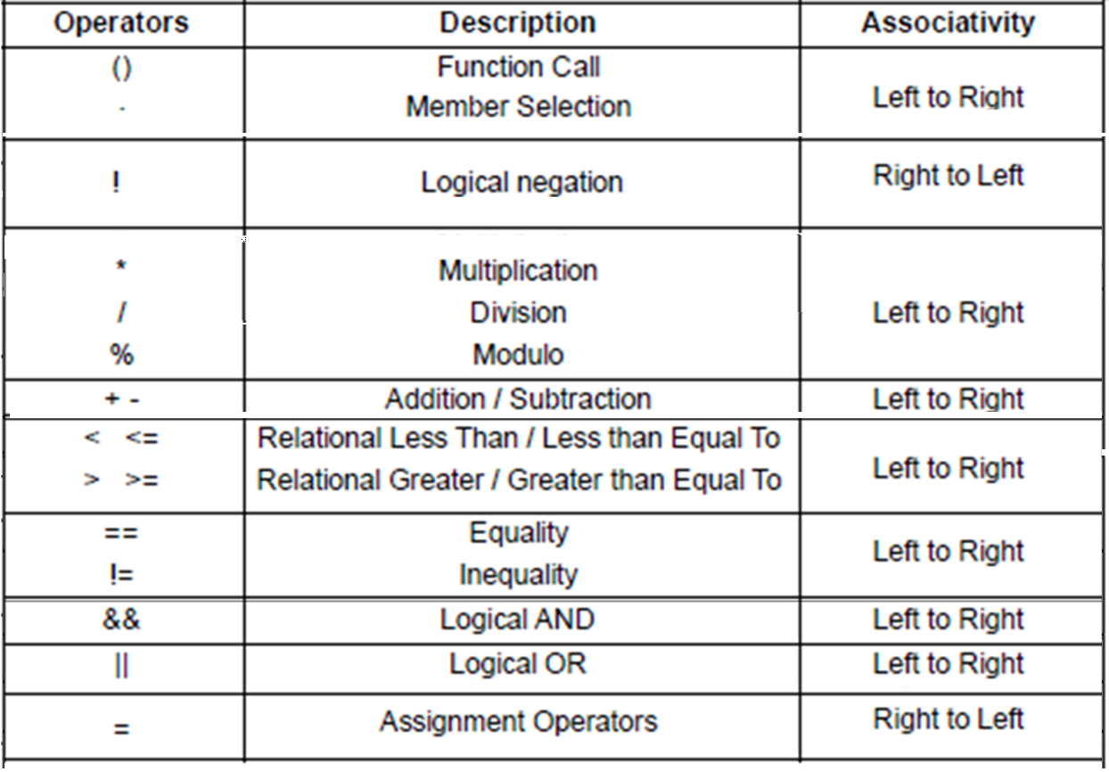

Slide 41
Operator Order of Precedence in Java
Associativity tells the direction of execution of operators

Slide 42
Testing with Boolean Operations
Uses of && and || usually mean more tests are appropriate

Slide 43
Testing with Boolean Operations
Uses of && and || usually mean more tests are appropriate
if (x == 1 || x == 5) { return 7;
} else if (x return 8;
} else { return 55;
}
> 7 && x <= 20) {

Slide 44
Testing with Boolean Operations
Uses of && and || usually mean more tests are appropriate
Test: x = 1
if (x == 1 || x == 5) { return 7;
} else if (x return 8;
} else { return 55;
}
> 7 && x <= 20) {

Slide 45
Testing with Boolean Operations
Uses of && and || usually mean more tests are appropriate
Test: x = 1 Test: x = 5 if (x == 1 || x == 5) {
return 7;
} else if (x return 8;
} else { return 55;
}
> 7 && x <= 20) {

Slide 46
Testing with Boolean Operations Uses of && and || usually mean more tests are appropriate
if | Test: x (x == | = 1 | 1 || | Test: x = x == 5) | 5 {
return 7; _{Test: x = 8} } else if (x > 7 && x <= 20) {
 | return | 8;
} | else {
 | return | 55;
}

Slide 47
Testing with Boolean Operations Uses of && and || usually mean more tests are appropriate
if | Test: x (x == | = 1 | 1 || | Test: x = x == 5) | 5 {
return 7; _{Test: x = 8} } else if (x > 7 && x <= 20) { return 8; } else { return 55; Test: x = 21 }

Slide 48
Putting it Together:
ComplexConditionalTest.java

